Slide 1



Name of Project: Plant Disease Detection
Name: Brijesh Kasaudhan
College: IMS Engineering College Ghaziabad

Slide 2

Learning Objectives
Understand Plant Pathology Basics
Learn common plant diseases, their symptoms and visual indicators.
Understand how early detection can prevent crop loss.
Apply Deep Learning for Image Classification
Learn how to build, train and evaluate Convolutional Neural Networks (CNNs).
Understand concepts like image preprocessing, data augmentation and transfer learning.
Work with Agricultural Image Datasets
Explore datasets like PlantVillage.
Learn how to clean, annotate and prepare image data for model training.
Develop an End-to-End AI System
Build a pipeline that connects image input → model prediction → result display.
Understand backend integration using FastAPI or Flask.
Improve Problem-Solving and Debugging Skills
Tackle challenges in model accuracy, overfitting and prediction errors.
Optimize performance and user experience through testing and iteration.
Gain Experience in Real-World AI Applications
Understand the role of AI in agriculture .
Learn to build solutions that can create real social and economic impact.
GOAL
Source :
www.freepik.com/

Slide 3
Tools and Technology used
🔍 AI & Machine Learning
Python – Core programming language for model and backend logic.
TensorFlow / Keras or PyTorch – For building and training the CNN model.
NumPy, Pandas, Matplotlib – Data manipulation, analysis and visualization.
OpenCV – Image processing and enhancement (e.g., resizing, filtering).
scikit-learn – Model evaluation metrics and utilities.
🖼️ Dataset & Annotation
PlantVillage Dataset – Open-source dataset with labeled images of plant diseases.
LabelImg / Roboflow (optional) – For manual annotation or custom dataset creation.

Slide 4
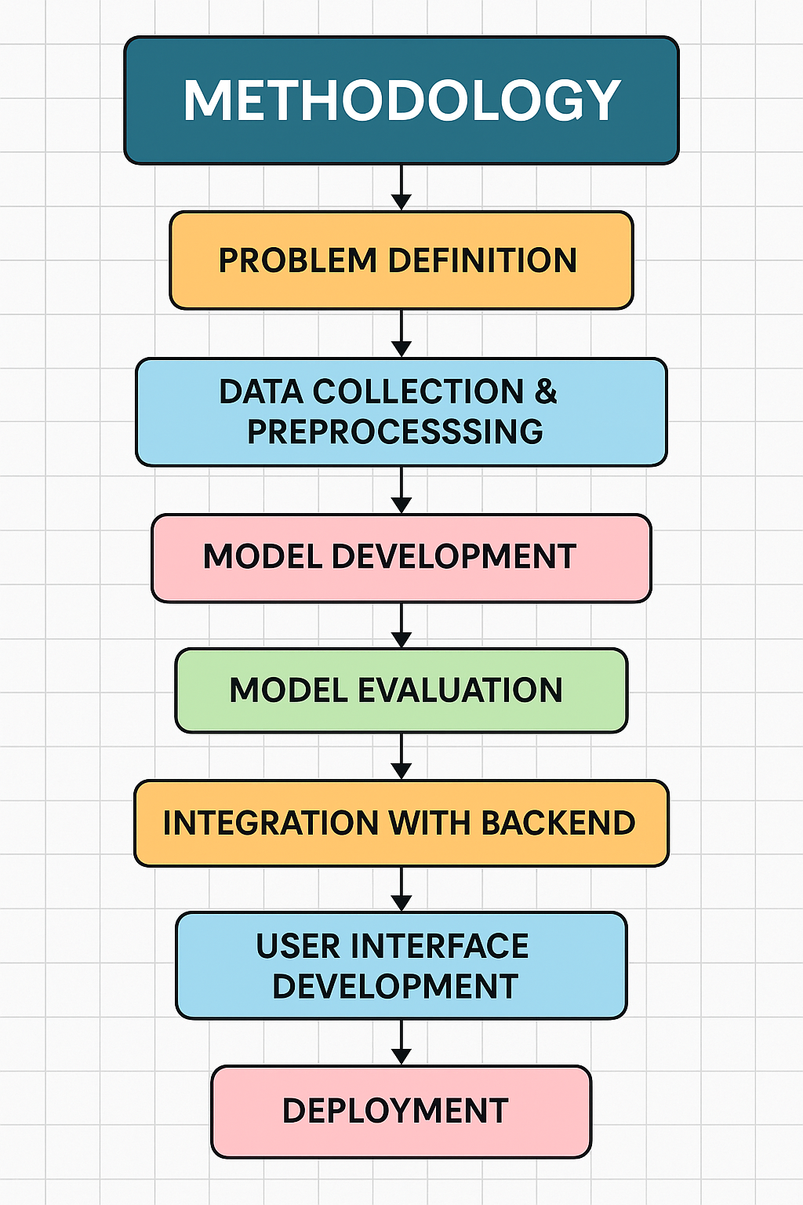
Methodology
The project follows a systematic AI development lifecycle, from dataset preparation to deployment. Below is a step-by-step breakdown:
1. Problem Definition
Identify the need for early plant disease detection to assist farmers and improve crop yield.
Define the objective: Build an AI-powered system that can classify plant diseases from leaf images.
2. Data Collection & Preprocessing
Dataset: Use the PlantVillage dataset (or other agricultural image datasets) containing thousands of labeled leaf images.
Preprocessing Steps:
Resize images (e.g., 224x224 pixels).
Normalize pixel values.
Perform Data Augmentation (rotation, flip, zoom) to reduce overfitting and improve generalization.
3. Model Development
Use Convolutional Neural Networks (CNNs) for image classification.
Architecture options:
Custom CNN
Transfer Learning using pretrained models like ResNet, MobileNet, or VGG16.
Training:
Split data into training, validation and test sets.
Use loss functions like categorical cross-entropy.
Optimize with Adam optimizer.
4. Model Evaluation
Evaluate model performance using:
Accuracy, Precision, Recall, F1-Score
Confusion Matrix to analyze class-wise performance.

Slide 5
Problem Statement:
Agriculture plays a vital role in global food security and the economy. However, plant diseases pose a significant threat to crop productivity, especially for small-scale farmers who may lack access to timely expert advice. Traditional disease diagnosis methods are time-consuming, expensive and require specialized knowledge.
There is a critical need for an accessible, fast and accurate solution that can assist farmers in identifying plant diseases early and taking appropriate action.
This project aims to develop an AI-powered Plant Disease Detection system that can analyze images of plant leaves and accurately identify diseases using deep learning. The solution will provide instant feedback along with suggested remedies, enabling farmers to take preventive or corrective measures, thereby reducing crop loss and improving agricultural outcomes.

Slide 6
Solution:
🔍 1. Image-Based Disease Detection
Users upload an image of a plant leaf.
The image is preprocessed and analyzed by a trained Convolutional Neural Network (CNN) model.
The system predicts the disease class with high accuracy and provides a confidence score.
🌐 2. Web or Mobile Interface
A simple and intuitive interface (using Streamlit or React) allows farmers and users to:
Upload leaf images.
Instantly receive disease diagnosis.
Access recommended treatments or links to agricultural resources.
🧠 3. AI Model Integration
Trained on datasets like PlantVillage.
Supports multiple crops (e.g., tomato, potato, maize).
Uses transfer learning for better accuracy and faster training.
🗂️ 4. Backend & API Services
The trained model is served via a FastAPI or Flask backend.
APIs process images and return disease predictions in real-time.
🚀 5. Deployment & Accessibility
The application is containerized using Docker.
Deployed on cloud platforms (e.g., Streamlit Cloud, Heroku, AWS) to ensure 24/7 access from anywhere.
Optional multilingual support for usability in rural areas.

Slide 7
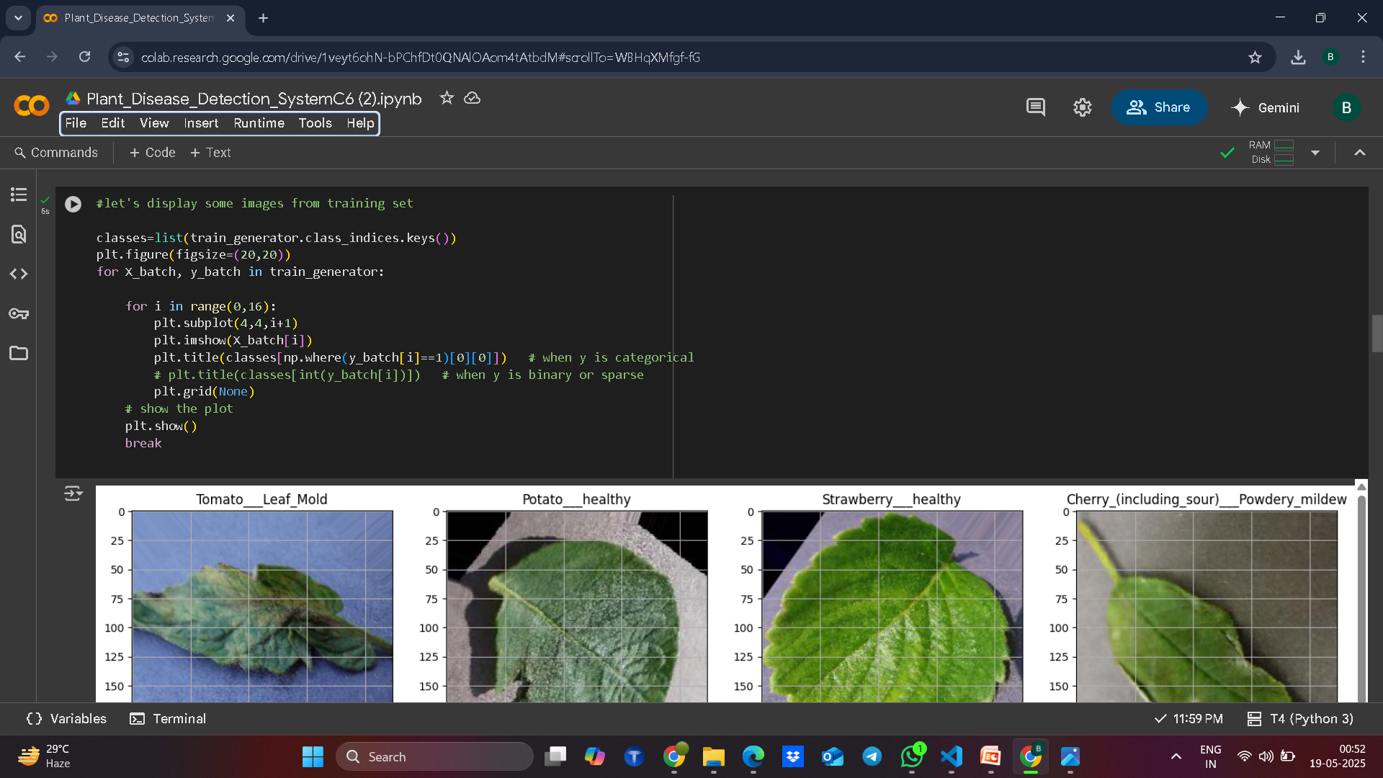
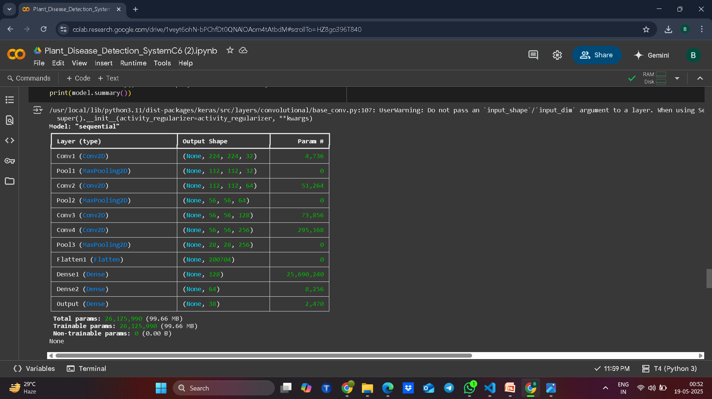
Screenshot of Output:

Slide 8
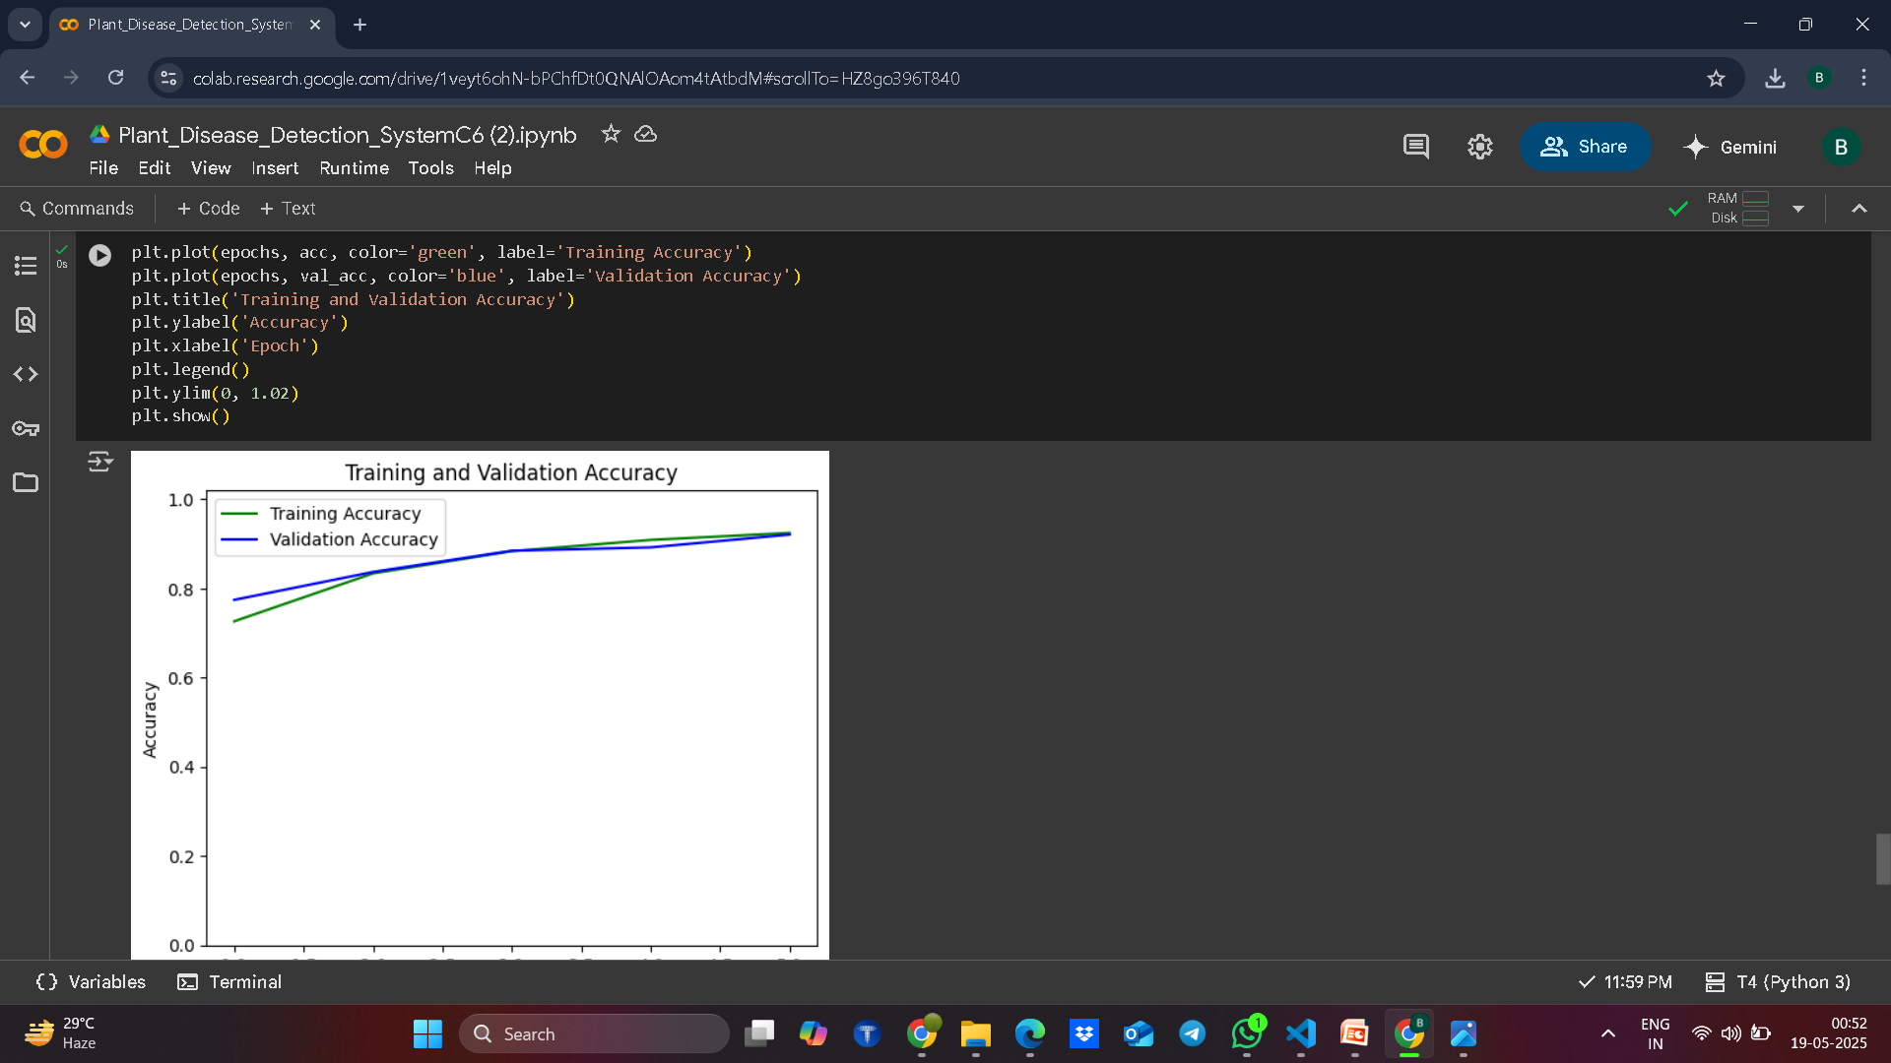
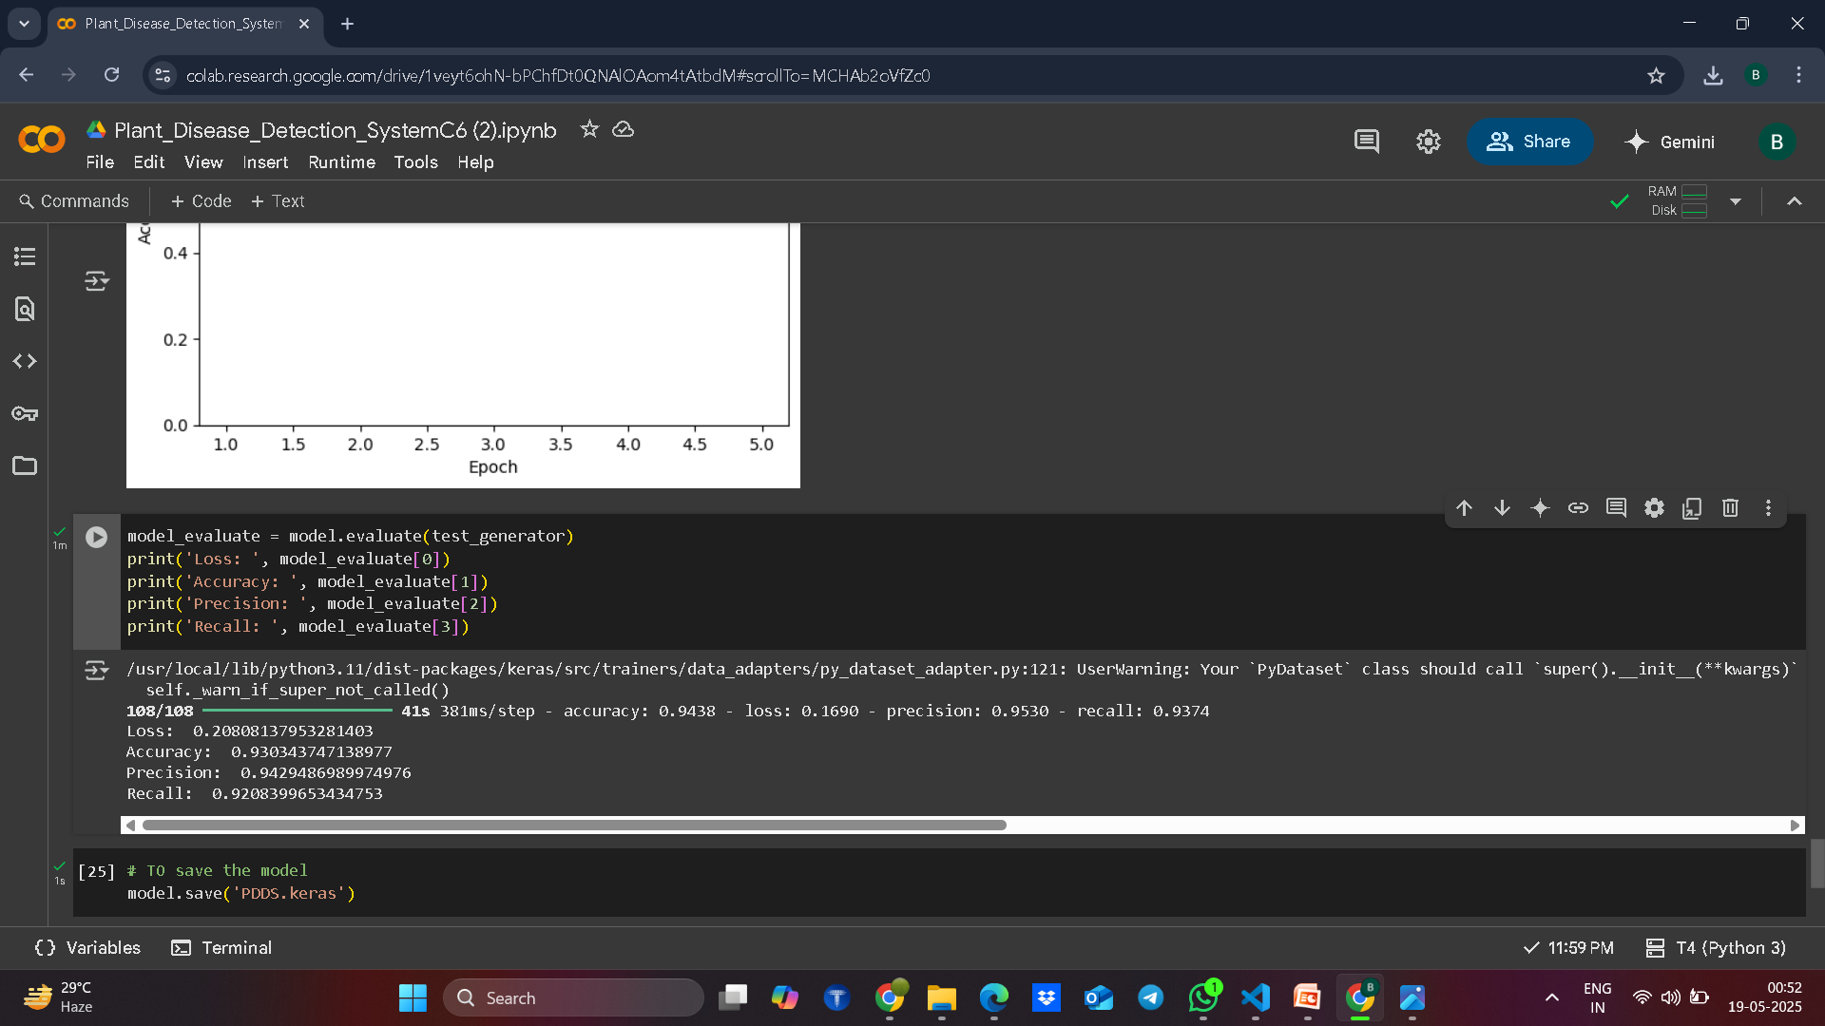
Screenshot of Output:

Slide 9
Conclusion:
The Plant Disease Detection system demonstrates how Artificial Intelligence and Deep Learning can be effectively applied in agriculture to address real-world challenges. By enabling rapid and accurate detection of plant diseases through image analysis, this solution empowers farmers to take timely action, reducing crop losses and improving productivity.
Through the integration of a user-friendly interface, a robust CNN-based prediction model and cloud deployment, the system ensures accessibility and usability for a wide range of users, including those in rural or remote areas.
This project not only enhances the efficiency of agricultural practices but also contributes to sustainable farming, food security, and the digital transformation of agriculture. With further improvements—such as real-time detection via mobile cameras, multilingual support, and integration with advisory systems—this solution has strong potential for large-scale adoption and social impact.

Slide 10
Thank You
Thank You
Thank You

